Slide 1



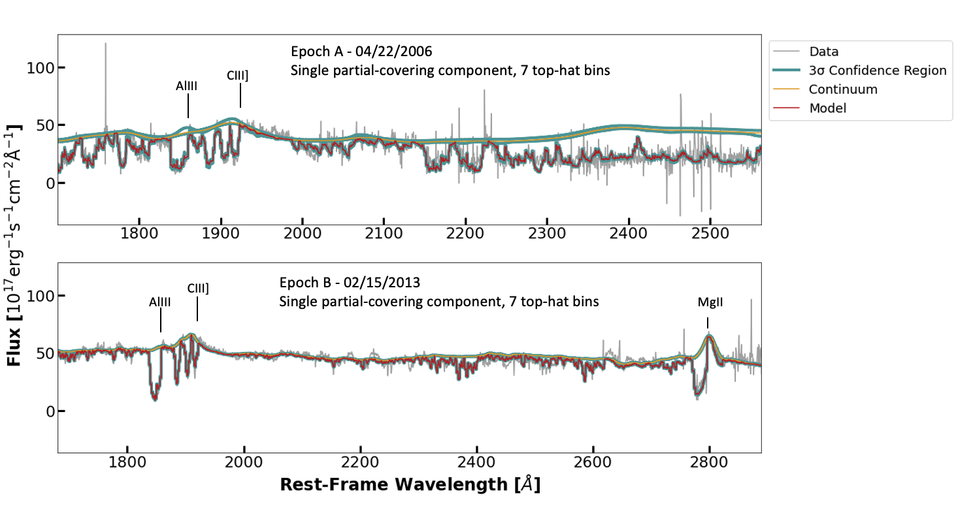
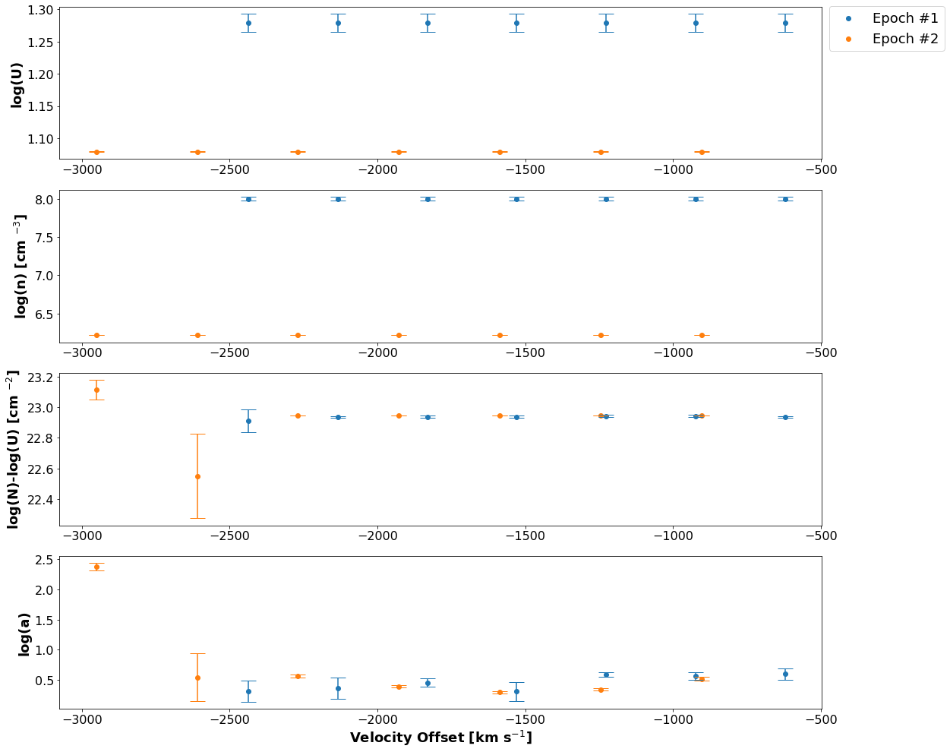
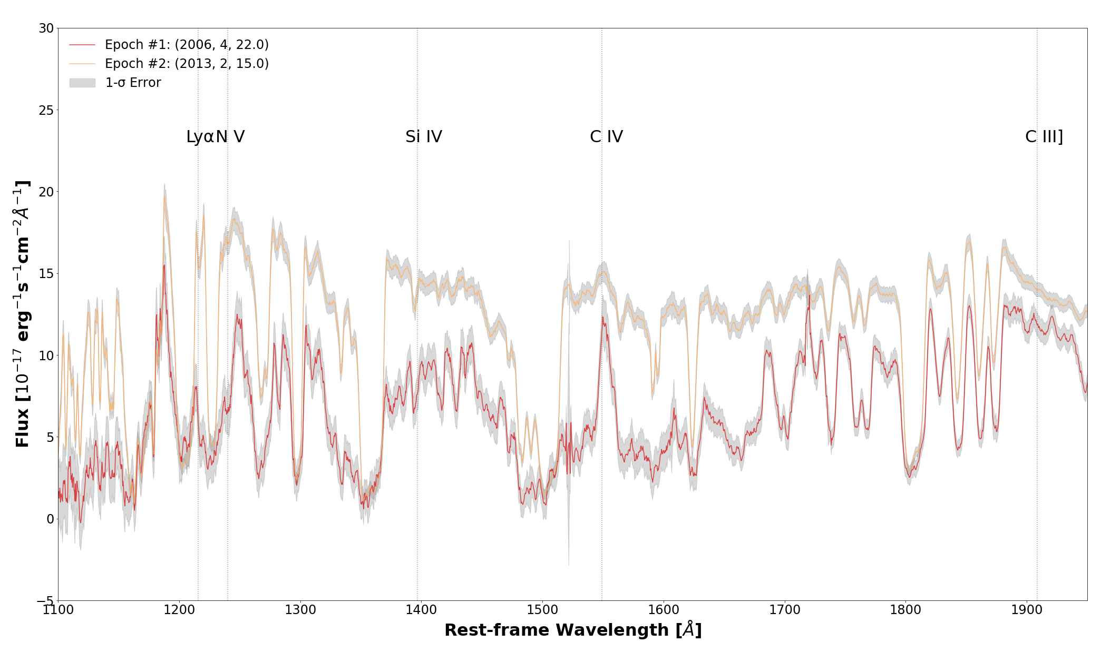
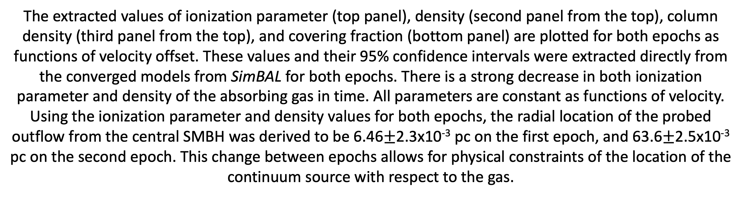
The Cause of Variability in FeLoBAL Quasar
SDSS J122933.32 +262131.2
Sofia Pasquini¹ Sarah Gallagher^{1,2,3,4}, Kaylie Green¹
¹ Dept. of Physics and Astronomy, University of Western Ontario, London, Ontario, Canada, N6A 3K7.
² Western Space, University of Western Ontario, London, Ontario, Canada, N6A 3K7.
³ Rotman Institute of Philosophy, University of Western Ontario, London, Ontario, Canada, N6A 3K7.
⁴ Canadian Space Agency, 6767 Route de l'Aéroport, Saint-Hubert, Québec, J3Y 8Y9
Abstract
Quasars are extremely bright, distant celestial objects powered by supermassive black holes (SMBHs) located at the centers of their host galaxies. Powerful mass outflows in quasars are believed to influence the interstellar medium as well as rates of star-formation in their host galaxies. Although quasars have been studied for decades, the structure and kinematics in their inner regions remain poorly understood. The optical and UV spectra of quasars can provide insights into the physical conditions and structures of the outflows in the inner regions of these objects which can lead to a better understanding of the link between quasars and their host galaxies. Variability studies of quasar outflows allows for better constraints on physical conditions of the gas such as its ionization state, column density, and the position of the outflow relative to the central supermassive black hole. Iron (Fe) Low-Ionization Broad Absorption Line (FeLoBAL) quasars make up the smallest fraction of the Broad Absorption Line (BAL) quasar subtype, which encompasses all quasars which have broad absorption features which are significantly blue-shifted from their broad emission lines. Though these objects are believed to host the most powerful outflows of the BAL quasar subtypes, they exist in the early Universe, and so these objects are significantly understudied. We have successfully fit multi-epoch observations of the variable FeLoBAL J122933.32+262131.2 using the novel software package, SimBAL which uses a spectral-synthesis forward-modeling procedure to effectively constrain physical parameters of the absorbing gas as a function of velocity. Our aim is to obtain a detailed model of the BAL region for J122933.32+262131.2 that could help clarify the location and power of the outflow to determine its impact on the host galaxy.
The best-fitting models for the first and second epochs are given in the top and bottom panels, respectively. These converged models each have a single partial-covering component and 7 top-hat bins to model spectral features.
From a sample of 440 FeLoBAL quasars, SDSS J122933.32 +262131.2 was confirmed to be showing evidence for variation in the time domain, and as such was chosen for this study.
Two epochs of spectroscopic observations for FeLoBAL SDSS 122933.32 +262131.2 taken from the Sloan Digital Sky Survey [1] [2] are plotted with some prominent features labelled. There is clear variability between epochs. An obvious increase in continuum flux levels larger than uncertainties from the first to second epoch is visible as well as variation in widths and depths of velocity components of absorption features between epochs.
Fitting Procedure
As an input, SimBAL [2], constructs synthetic spectra from grids of parameter values calculated by photoionization code Cloudy [3], and models the observed spectrum using a Markov Chain Monte Carlo (MCMC) method in physical parameter space. An advantage of using SimBAL over traditional spectroscopic fitting methods is that the identification of present spectral lines is not required. As such, the spectral analysis method adopted by SimBAL models the entire spectrum as opposed to only lines which are present, so constrained models reflect information from lines which are both present and absent [2].
After the MCMC method converges on a best-fitting model, the walker chains from the MCMC run can be sampled in post-processing in order to harvest model parameters and associated uncertainties. Such parameter values model the physical conditions of the absorbing gas.
The extracted values of ionization parameter (top panel), density (second panel from the top), column density (third panel from the top), and covering fraction (bottom panel) are plotted for both epochs as functions of velocity offset. These values and their 95% confidence intervals were extracted directly from the converged models from SimBAL for both epochs. There is a strong decrease in both ionization parameter and density of the absorbing gas in time. All parameters are constant as functions of velocity. Using the ionization parameter and density values for both epochs, the radial location of the probed outflow from the central SMBH was derived to be 6.46$±$2.3x10⁻³ pc on the first epoch, and 63.6$±$2.5x10⁻³ pc on the second epoch. This change between epochs allows for physical constraints of the location of the continuum source with respect to the gas.
Future Work
In order to confirm these dynamical changes and confirm the physical mechanism which allows these changes to occur, further analyses of the best-fitting models must be performed. Such verification would address which changes in parameter values would be responsible for the changes which are observed in the spectra. Other quantitative outflow properties such as mass loss rate, momentum, and energy may also be derived from best-fitting parameters which would help to illustrate the large-scale, dynamical properties of quasar outflows which cause variability in their observed spectra, and further, to draw conclusions regarding the relationships of such outflows on their host galaxies.
[1] Adelman-McCarthy, J. K., Agüeros, M. A., Allam, S. S., Anderson, K. S., Anderson, S. F., Annis, J., ... & Yocum, D. R. (2007). The fifth data release of the Sloan Digital Sky Survey. The Astrophysical Journal Supplement Series, 172(2), 634.
[2] Alam, S., Albareti, F. D., Prieto, C. A., Anders, F., Anderson, S. F., Anderton, T., ... & Manera, M. (2015). The eleventh and twelfth data releases of the Sloan Digital Sky Survey: final data from SDSS-III. The Astrophysical Journal Supplement Series, 219(1), 12.
[3] Leighly, K. M., Terndrup, D. M., Gallagher, S. C., Richards, G. T., & Dietrich, M. (2018). The z= 0.54 LoBAL Quasar SDSS J085053. 12+ 445122.5. I. Spectral Synthesis Analysis Reveals a Massive Outflow. The Astrophysical Journal, 866(1), 7.
[4] Ferland, G. J., Chatzikos, M., Guzmán, F., Lykins, M. L., Van Hoof, P. A. M., Williams, R. J. R., ... & Stancil, P. C. (2017). The 2017 Release of cloudy. Revista Mexicana de Astronomia y Astrofisica, 53(2).

